Slide 1
UDP Protocols
Bardia Nikbakhsh

Slide 2
UDP

Slide 3
User Datagram Protocol
Transport Layer
End-to-End
Connectionless
Lack of Data Delivery Guarantee
Fast protocol

Slide 4
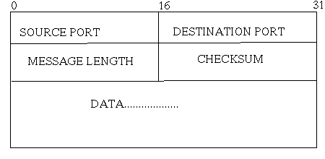
UDP packet format

Slide 5


Applications of UDP

Slide 6
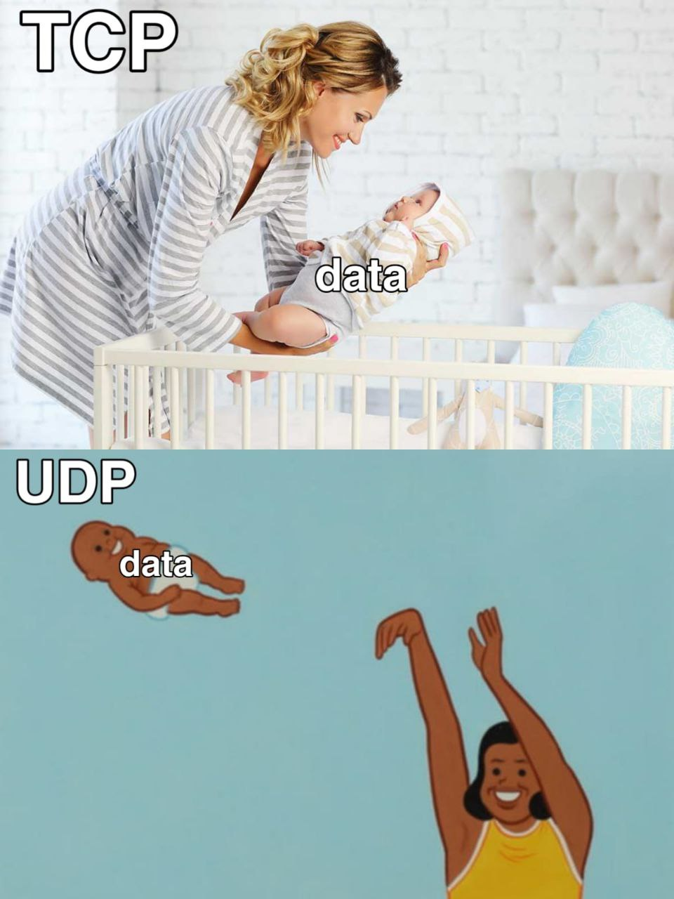
UDP vs TCP

Slide 7
The End

